Slide 1


Slide 2
Company Profile Incorporated in 2000 by Mr Kishore Chandni, Sunrise Exports is one of the leading manufacturers exporters and suppliers of all types of biscuits. GLUCOSE BISCUITS CREAM BISCUITS NICE BISCUITS

Slide 3
QUALITY
Committed to quality as all our products are subjected to stringent ISO STD TESTS.
Products tested on various parameters.
Quality achieved by number of inspection procedures performed by professional production technicians.
Finest raw materials used in production. Products are met to quality standards before reaching the market.
Regular quality checks conducted to maintain quality standards of the final product that reaches the market.
Dedicated to provide our customers with the finest quality products and services, assuring timely of orders.

Slide 4
Factors which have helped us in creating niche in a short span of time
Quality goods
Timely delivery
Customer satisfaction
Easy mode of payment
Professional team of workers
Large clientele base

Slide 5
OUR CLIENTELE
West Africa
South Africa
Central Africa
Middle East Countries

Slide 6
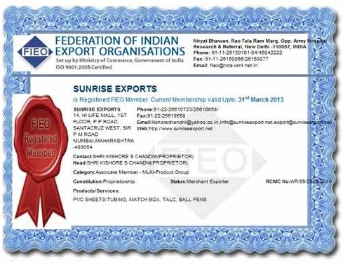
Memberships We are registered members of the federation of indian export organization, Govt of India.

Slide 7
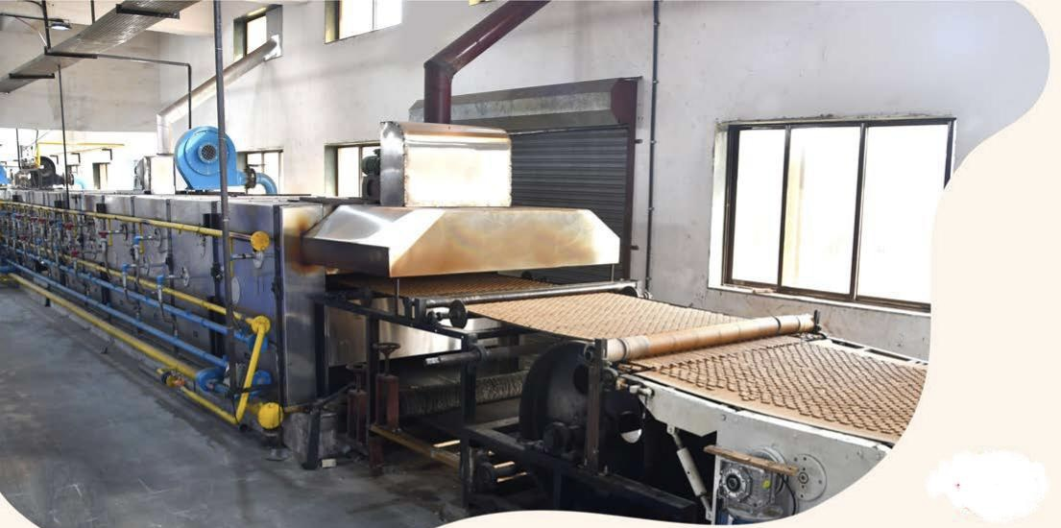
FACTORY

Slide 8
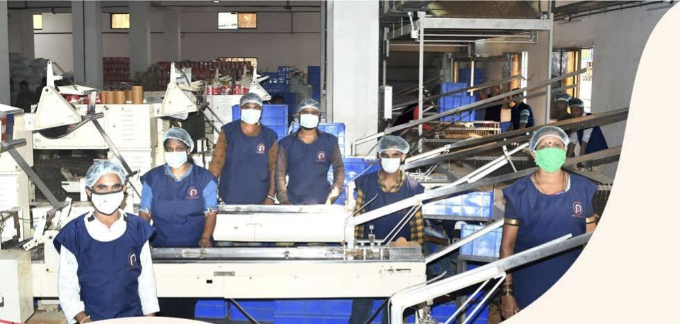
FACTORY

Slide 9
COMPANY USP
Installation Training
Onsite Support
Operational Training
User Manual
Experienced R & D Department
Large Production Capacity
Large Product Line
Best Testing Facilities

Slide 10
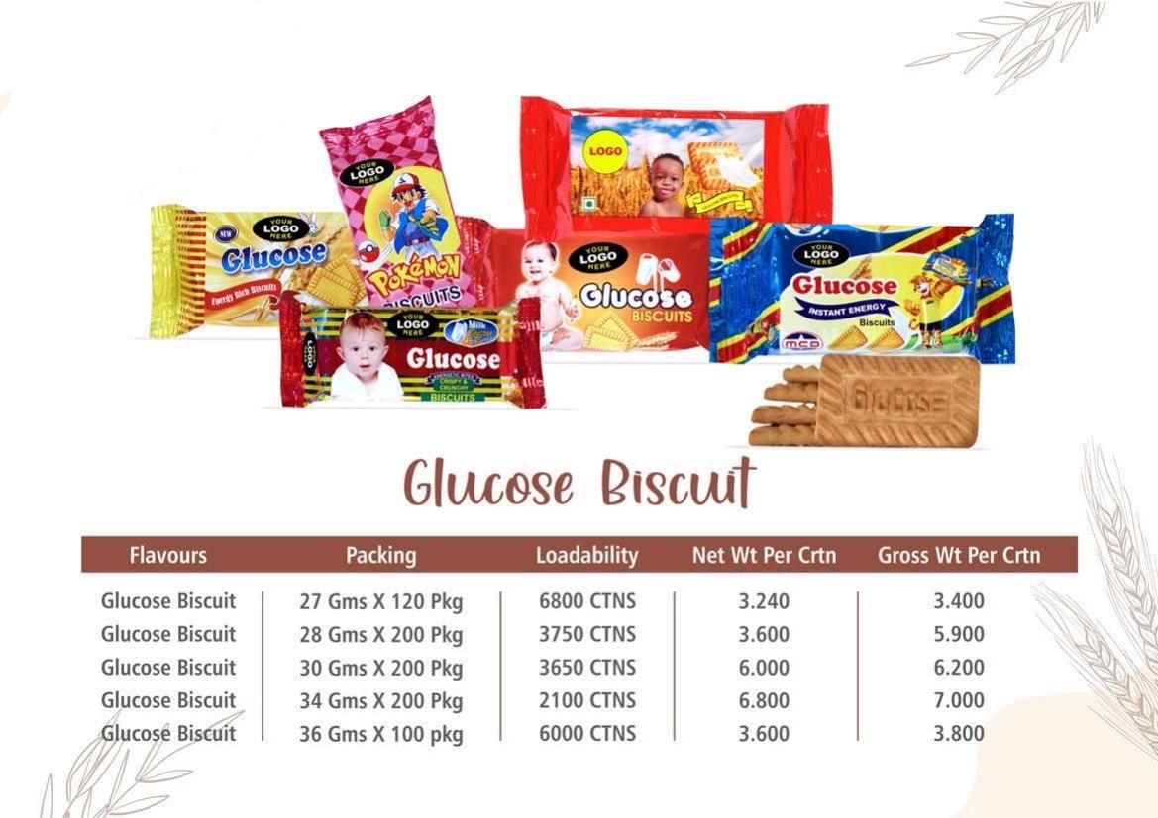
OUR PRODUCTS GLUCOSE BISCUITS

Slide 11
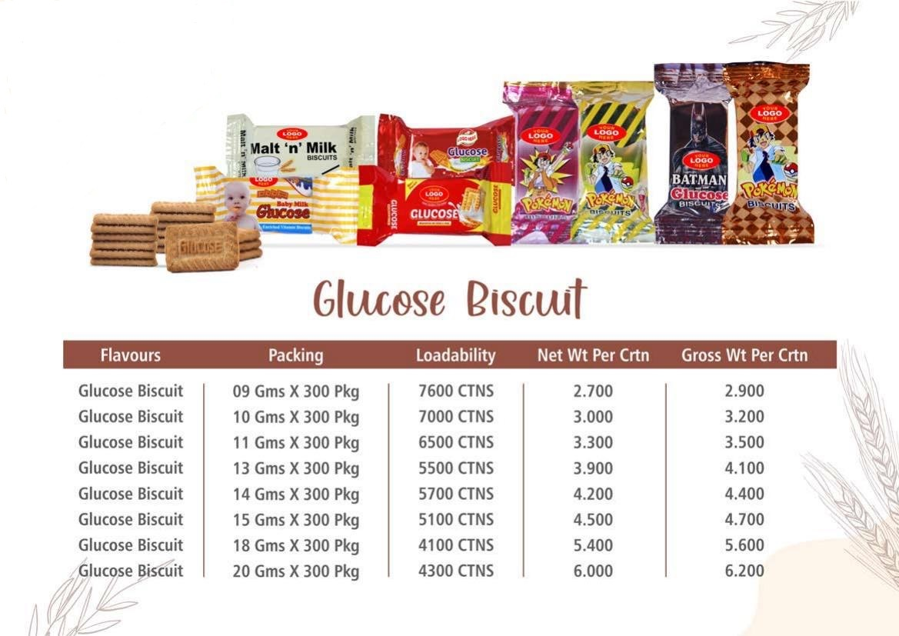
OUR PRODUCTS GLUCOSE BISCUITS

Slide 12
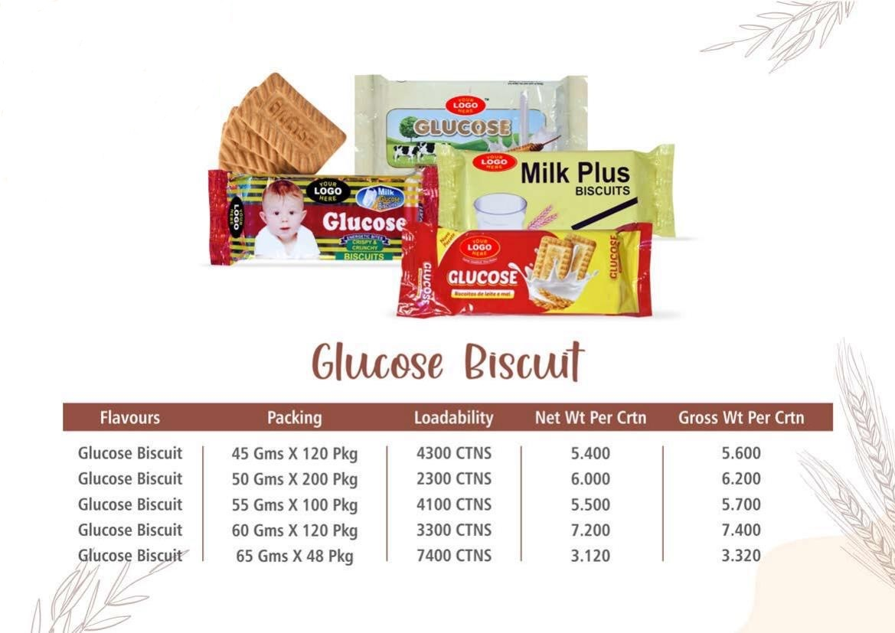
OUR PRODUCTS GLUCOSE BISCUITS

Slide 13
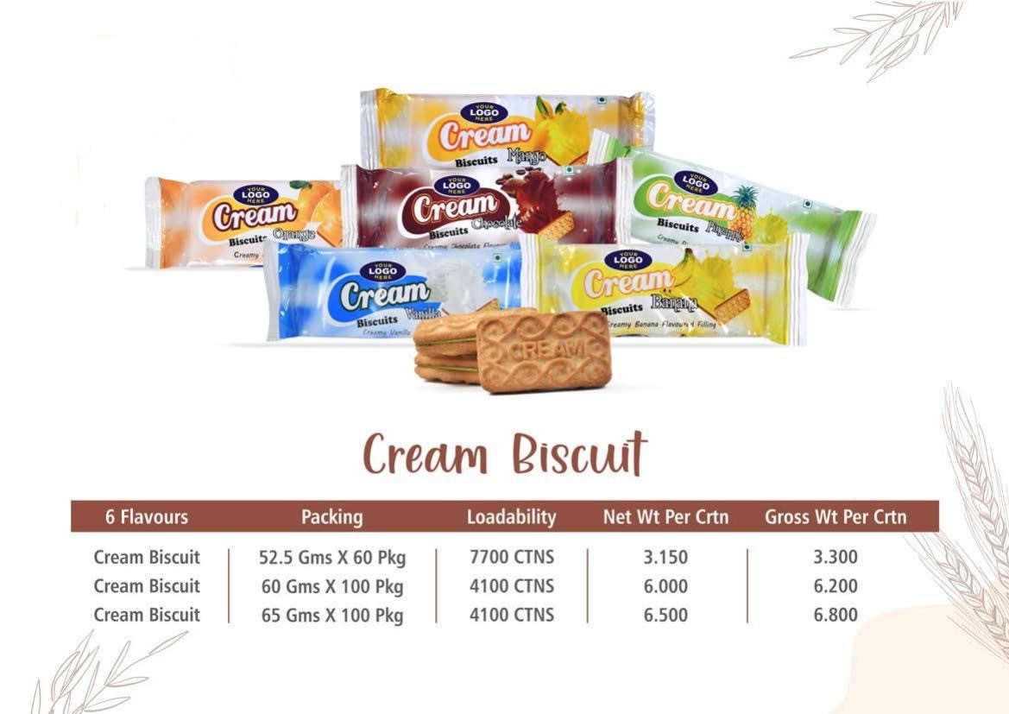
OUR PRODUCTS CREAM BISCUITS

Slide 14
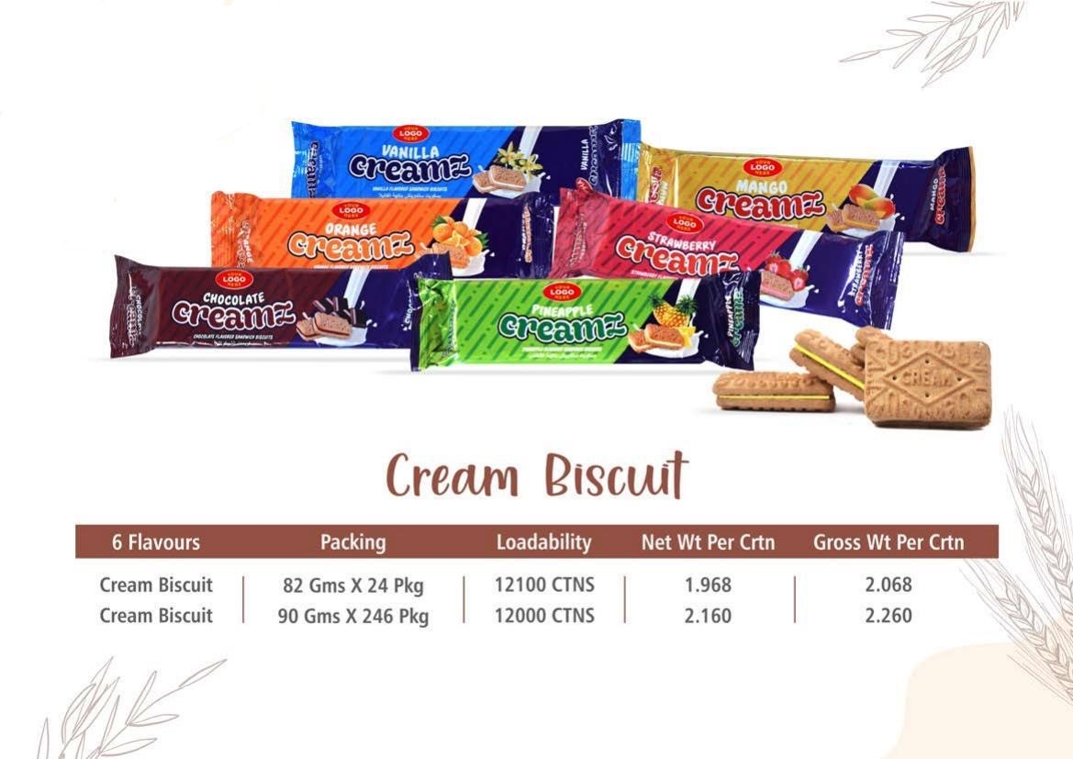
OUR PRODUCTS CREAM BISCUITS

Slide 15
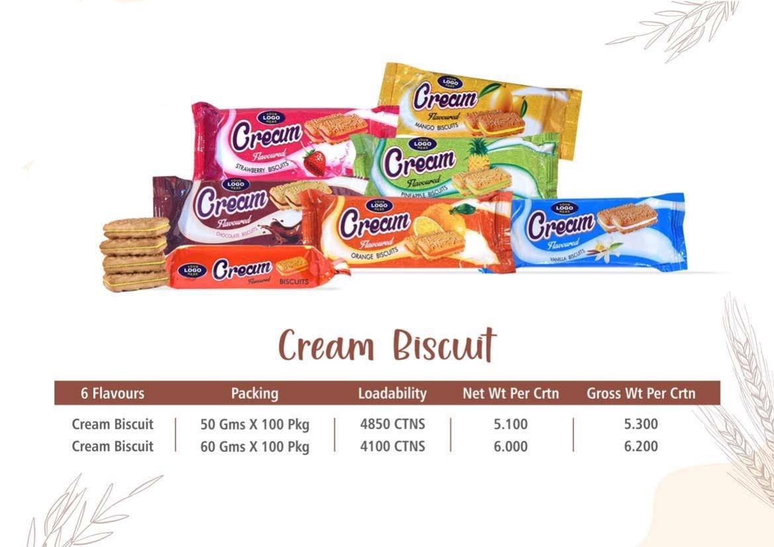
OUR PRODUCTS CREAM BISCUITS

Slide 16
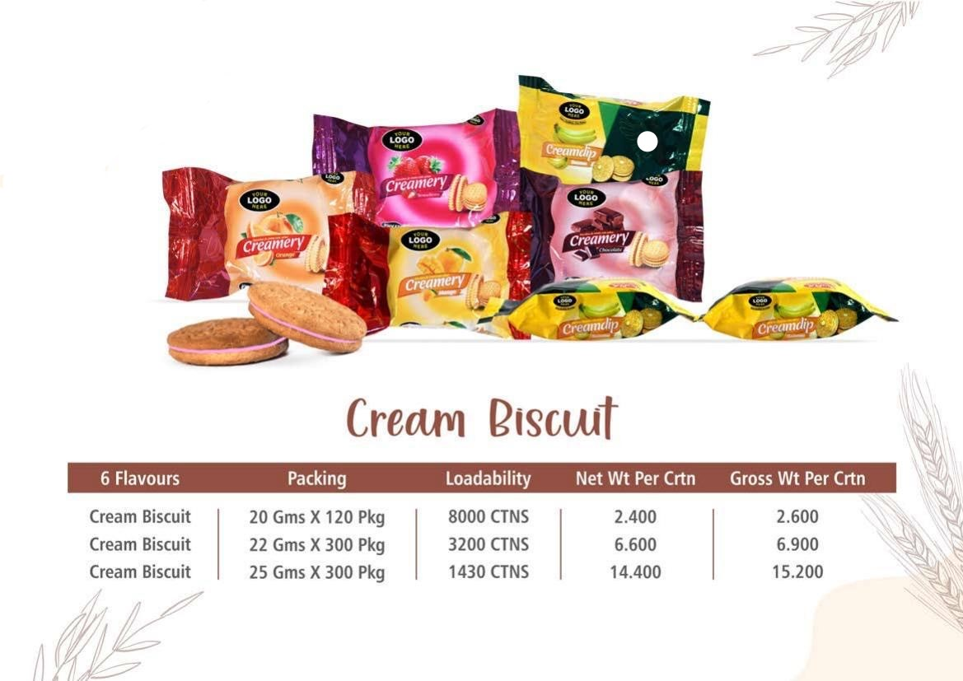
OUR PRODUCTS CREAM BISCUITS

Slide 17
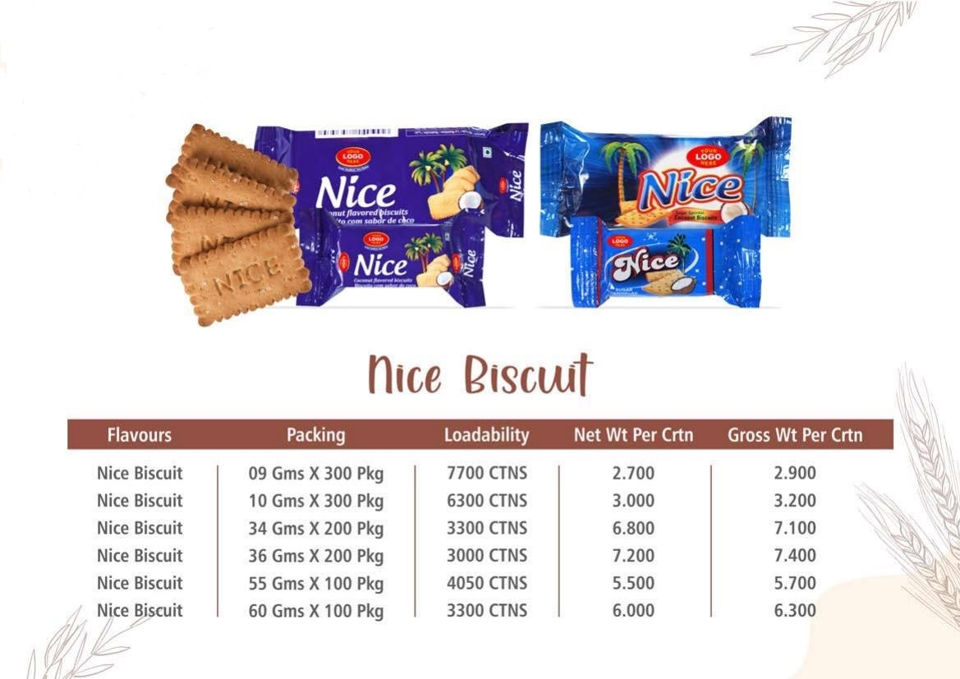
OUR PRODUCTS NICE BISCUITS

Slide 18
CONTACT DETAILS: KISHORE CHANDNI (CEO) ADDRESS: F-14, HI-LIFE MALL, 1st FLOOR, P.M.ROAD, SANTACRUZ WEST, MUMBAI 400054 MAHARASHTRA, INDIA

Slide 19
THANK YOU info@sunriseexport.net

